Slide 1
Neurodevelopmental differences in affective representations between adults and children:
A presentation for Yale University’s FABLAB
Billy Mitchell
Notes:
Hi everybody Thank you so much for having me. My name is Billy Mitchell and I'm a graduate student in Chelsea Helion's Social and Affective Neuroscience lab at Temple.
And I’m very honored to be able to talk to you about some of the research we have going on here.

Slide 2







The Social & Affective Neuroscience Lab
Chelsea Helion
Billy Mitchell
Joy Ham
Ginny Ulichney
Helen Schmidt
Do self-regulatory abilities carry across domains?
How does context influence regulatory decisions?
How do self-schemas inform socioemotional outcomes?
How can we overcome difficulties in giving/receiving feedback?
How does affective labeling help regulate emotions?
Notes:
And, as you might guess from the name,
I and the other researchers in the lab
are very interested in understanding social and affective mechanisms,
And how these things develop over time.
(PAUSE)
here I just have a little summary of my lovely labmates and their work
And you might notice that self-regulation and context tend to come up quite a bit.
As a general theme in our lab, we often focus on leveraging naturalistic stimuli
To explore self-regulatory mechanisms
And that’s for pragmatic reasons
(PAUSE)

Slide 3

Notes:
Ya know, wow are we supposed to understand whether somebody is behaving adaptively without understanding the circumstances to which they're adapting.
Affective experiences in the real world aren’t stagnant.
They are dynamic,
multimodal,
often social,
And unfold over a time course, not an instant
(PAUSE)
For example,
I really love this photo and how powerpoint initially made the decision to present it.
Here, it just looks like a kid thriving,
They won their chess match and are appropriately savoring the positive experience
Which can be a robust means of promoting long term health outcomes. a real regulation success story.
(PAUSE)
But it’s actually a great case for why context matters in regulation
Because when you see what I originally saw

Slide 4
Notes:
We see that there are other considerations to be had.
My real passion is studying when and why we downregulate positive emotions
So maybe I’m a little biased, but I think this kid could stand to tone it down a little.

Slide 5

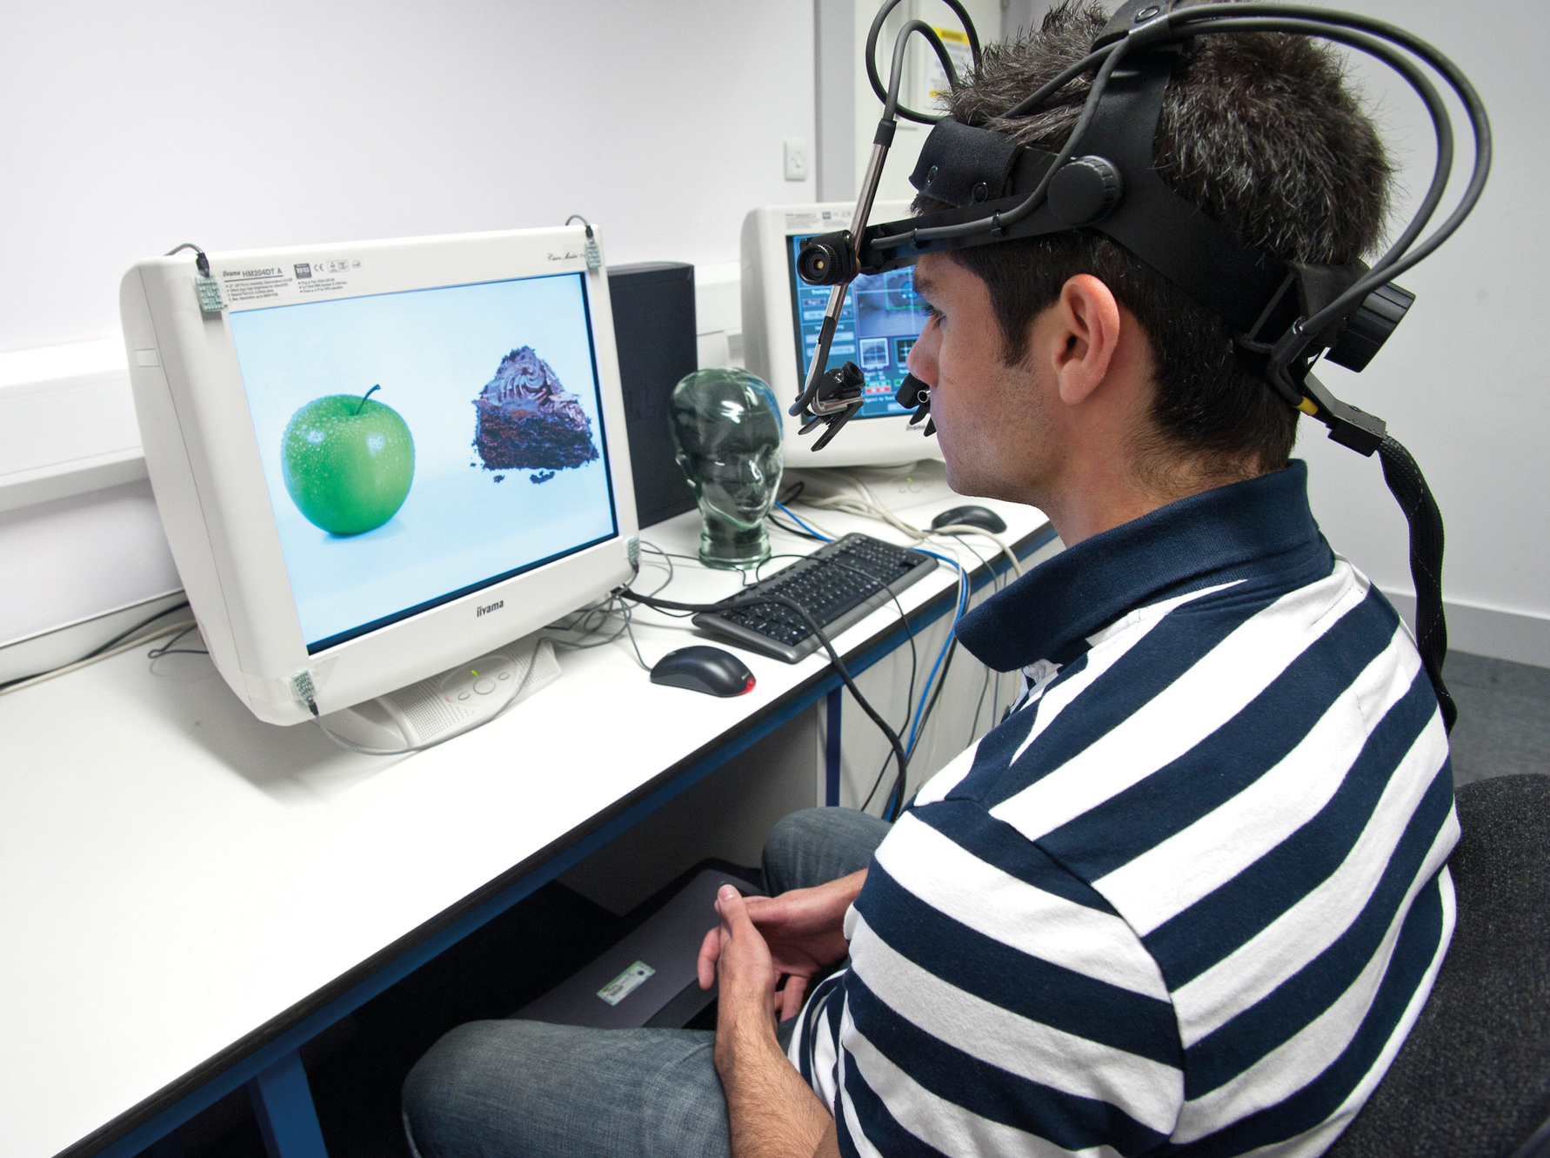
My Primary Research Interests
Primarily interested in using naturalistic stimuli to study how context influences choices in people's self-regulatory behaviors and cognitions.
Bridging a gap between regulation in the lab and out of the lab.
Notes:
So I primarily use naturalistic stimuli to study how context influences choices in people's self-regulatory behaviors and cognitions.
For all of the reasons I just stated, we sometimes run into issues translating self-regulation research
that we're capturing in the very controllable, very ideal conditions of the lab to that of the messy, convoluted realities of daily life
And I see my approach as an important supplement to that very important, broken-down-to-its-elements approach that typically characterizes emotion regulation research

Slide 6
Emotion Precedes Its Regulation
Affective Regulation Pipeline
Experience
Processing
Feeding different information into the same processes may produce different results.
Differences can exist between two people measured at the same point in time or the same person measured across time.
Representation
Assessment
Regulation
Behavior
Notes:
Because there are still hurdles standing between where we are now and a future in which we understand the intersection between context and choosing the regulation course that leads to ideal outcomes.
It's maybe obvious to state, but affective information exists upstream of the processes that regulate it ,
That is to say, there’s a pipeline through which affective information much travel before it affects outcomes.
This is by no means a formalized model
That necessarily represents all of the complications and caveats inherent to affective processing
Think of it more as a basic visualization so that I can keep my very distractable brain on task
And help you all to follow the stages as I think of them.
This is a adapted and modified a little from a meta-monitoring loop Carver and Scheier proposed in a 1980 paper which I love.
But again, I’ve made some changes for my purposes.

Slide 7
Emotion Precedes Its Regulation
Affective Regulation Pipeline
Something happens
Experience
Perception
Feeding different information into the same processes may produce different results.
Differences can exist between two people measured at the same point in time or the same person measured across time.
Representation
Assessment
Regulation
Behavior
Notes:
So we start by some affectively relevant event occurring, some experience which can be then

Slide 8
Emotion Precedes Its Regulation
Something happens
Experience
We notice it happens
Processing
Feeding different information into the same processes may produce different results.
Differences can exist between two people measured at the same point in time or the same person measured across time.
Representation
Assessment
Regulation
Behavior
Notes:
Perceived by our unimodal sensory receptors, enter our brain and begin to make its way towards more transmodal network hubs

Slide 9
Emotion Precedes Its Regulation
Something happens
Experience
We notice it happens
Processing
Feeding different information into the same processes may produce different results.
Differences can exist between two people measured at the same point in time or the same person measured across time.
We process the event, identify relevant info
Representation
Assessment
Regulation
Behavior
Notes:
At which point, the information begins to get integrated and representations of what we’ve experienced begin to form. We can think of this part of the process as making connections, and trying to get a veridical picture of the event

Slide 10
Emotion Precedes Its Regulation
Something happens
Experience
We notice it happens
Processing
Feeding different information into the same processes may produce different results.
Differences can exist between two people measured at the same point in time or the same person measured across time.
We process the event, identify relevant info
Representation
We evaluate our circumstance
Assessment
Regulation
Behavior
Notes:
So that we can assess its relevance us our circumstances and our broader goals. If our assessments recognize an incongruence, or the meaning that we derive from this event does not match our goals,

Slide 11
Emotion Precedes Its Regulation
Something happens
Experience
We notice it happens
Processing
Feeding different information into the same processes may produce different results.
Differences can exist between two people measured at the same point in time or the same person measured across time.
We process the event, identify relevant info
Representation
We evaluate our circumstance
Assessment
We make decisions
Regulation
Behavior
Notes:
We may then engage regulatory cognitions to help align our affective states with our goals

Slide 12
Emotion Precedes Its Regulation
Something happens
Experience
We notice it happens
Processing
Feeding different information into the same processes may produce different results.
Differences can exist between two people measured at the same point in time or the same person measured across time.
We process the event, identify relevant info
Representation
We evaluate our circumstance
Assessment
We make decisions
Regulation
We take observable action
Behavior
Notes:
And make changes to our circumstances to achieve those goals.
And again, this is an oversimplified model.
In reality, there exists derivates of this like trying to pre-emptively regulate affective experiences that haven’t happen yet
And regulating our regulations
But for illustrative purposes
This linear model is a little easier to digest.
(PAUSE)
so again, before we can think about making broader statements about regulation,
it's important that we understand the information that's being fed into the regulation processes.

Slide 13
Emotion Precedes Its Regulation
Something happens
Experience
We notice it happens
Processing
Feeding different information into the same processes may produce different results.
Differences can exist between two people measured at the same point in time or the same person measured across time.
We process the event, identify relevant info
Representation
We evaluate our circumstance
Assessment
We make decisions
Regulation
We take observable action
Behavior
Notes:
If two people were thinking about the same affective experience in different ways it maybe reasonable to assume that later stages would differ as well.
because not only could these differences exist from person to person, but also within the same person across development.

Slide 14
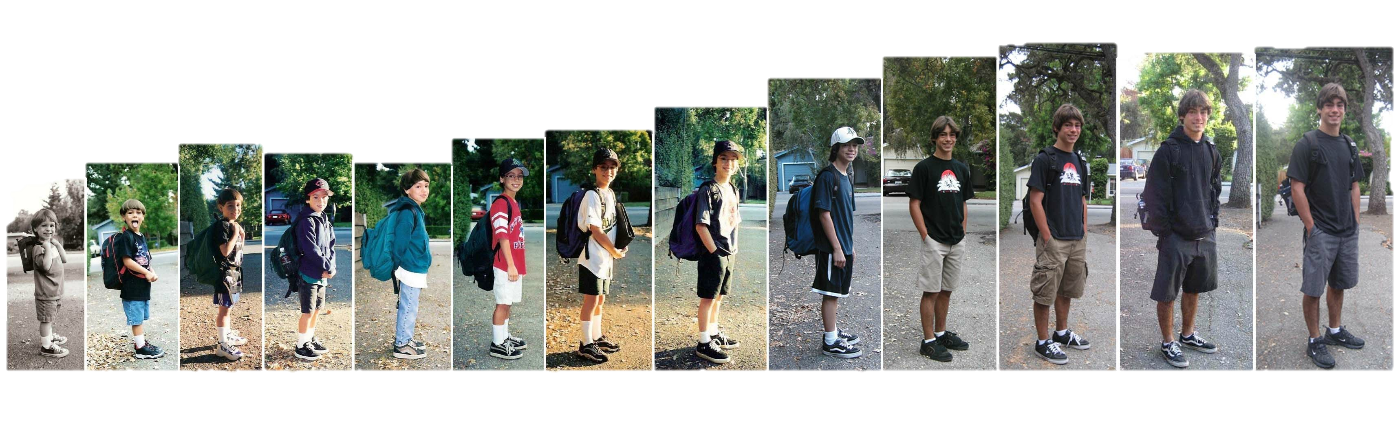

Development is a context crucial to understanding affective cognitions, experiences, and expressions
Notes:
As such, development is a context that is absolutely crucial to our understanding of affective phenomena.
previous research has identified some milestones in behavioral and neural development that should have implications on this phenomena.

Slide 15

Development & Affective Behavior
Children as young as 2 years use language to express emotions ¹
Children are better at recognizing others’ emotions with age ²
Emotional development is influenced by:
Family ³
Peers ²
Language ⁴⁻⁷
Development adds to nuance to representations of affective information via Differentiation Models ^{5,8}
Valence still holds significance, but is not as defining to emotion differentiation in adulthood ⁹⁻¹¹
1 Wellman et al., 1995
2 Fabes et al., 1991
3 Dunn et al., 1991
4 de Rosnay and Harris, 2002
5 Pons et al., 2003
6 Nook et al., 2017
7 Hoemann et al., 2019
8 Widen & Russel, 2003
9 Ansfield, 2007
10 Krumhuber and Manstead, 2009
11 Szczurek et al., 2012
Notes:
Developmental literature on emotion has found that affective expression starts early
and that the complexity of semantic expression
as well as the ability to recognize emotions in others increases with age through early development
(PAUSE)
These gains seem to be moderated by the richness of one’s social environment.
Kids that grow up within families and among peers that give greater prominence to affective expression
And exposure to more complex language tend to have more advanced emotion expression and labeling skills.
(PAUSE)
One of the proposed mechanisms is that these different mediums function to improve representations of affective information
and this notion largely comes from differentiation models of emotional development
which suggest that kids start out with relatively simplistic understandings of emotion
that fall pretty tightly along valence lines like Good and Bad or Positive and Negative
and grow progressively more nuanced and complex with age.

Slide 16
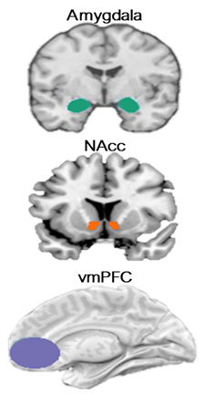
Affective Neural Development
Several prefrontal and subcortical affectively-relevant regions undergo structural and functional changes across development
Ventromedial Prefrontal Cortex (vmPFC) ¹⁻²
Amygdala (AMY) ³⁻⁵
Nucleus Accumbens (NAcc) ⁶
In adults, the AMY and ventral striatum (VS) process the perception of valence ^{3,6}
Exert neuromodulatory influences on prefrontal circuitry. ^{3,6}
The vmPFC outputs back to the AMY and VS, which may function as an affect and attention network. ⁷
mPFC-AMY connectivity alters around age 10 and vmPFC-to-AMY projections my emerge later than AMY-to-vmPFC projections ^{1, 8,9}
vmPFC is crucial in emotion classification ^{10,11}
1 Gee et al., 2013
2 Jalbrzikowski et al., 2017
3 Davis and Whalen, 2001
4 Perlman and Pelphrey, 2011
5 Gabard-Durnam et al., 2014
6 Levita et al., 2009
7 Bjanji et al., 2019
8 Bouwmeester et al., 2002a
9 Bouwmeester et al., 2002b
10 Satpute et al., 2016
11 Saarimaki et al., 2016
Notes:
At the same time we have a bevy of changes in neural structure and function as well,
especially between prefrontal regions like the ventromedial prefrontal cortex and subcortical regions like the nucleus accumbens, and amygdala.
(PAUSE)
These structures are often implicated in how we assess and assign affectively relevant values to things we see
and they exist within an affect network,
but their connections to each other change across development.
(PAUSE)
We often see the amygdala and ventral striatum subregions exerting neuromodulatory influence on prefrontal regions across development,
but the projections from the vmPFC back to subcortical regions may only develop and strengthen later in childhood development.
(PAUSE)
This is very important to understanding affect in neuroscience
because we often associate vmPFC neural signatures with emotion regulation and differentiation abilities in adults.
So without strong projections from the vmPFC back to these subcortical regions,
essentially a prefrontal-subcortical feedback loop,
we may not see as great of an ability to actively shape affective information.

Slide 17


Early normative affective development is characterized by a movement away from visceral, affective experiences to evaluative affective processes which is facilitated by the relatively late development of regulatory systems ¹
1 Casey, Getz, & Galvan, 2008;
Notes:
And so collectively, this paints a picture that I’m sure is very familiar to all of you and the work you’re doing in the FABLAB
That the trajectory of early normative affective development may be characterized by a movement away from visceral, affective experiences to evaluative processes which benefit from and are facilitated by relatively late development of these regulatory feedback loops.
This is especially the case post-adolescence when some of the changes I’d highlighted reach maturation

Slide 18

What don’t we know?
Experience
Processing
How might developments in neural affective structures and function influence cognition and subsequent behavior?
Representation
Assessment
Regulation
Behavior
This Photo by Unknown Author is licensed under CC BY
Notes:
So while we know a bit about behavioral changes across development,

Slide 19
What don’t we know?
Experience
Processing
How might developments in neural affective structures and function influence cognition and subsequent behavior?
Representation
Assessment
Regulation
Behavior
This Photo by Unknown Author is licensed under CC BY
Notes:
and we know a bit about neural changes across development,

Slide 20
What don’t we know?
Experience
Processing
How might developments in neural affective structures and function influence cognition and subsequent behavior?
Representation
Assessment
Regulation
Behavior
This Photo by Unknown Author is licensed under CC BY
Notes:
(POINT TO BRIDGE)
what's relatively less understood is the bridge between neural structure and function and observable behaviors.

Slide 21





THE BIG QUESTION
How similarly do children and adults process the same affective information?
Notes:
And so the big question I’d focused on with the project I’m presenting today is

Slide 22
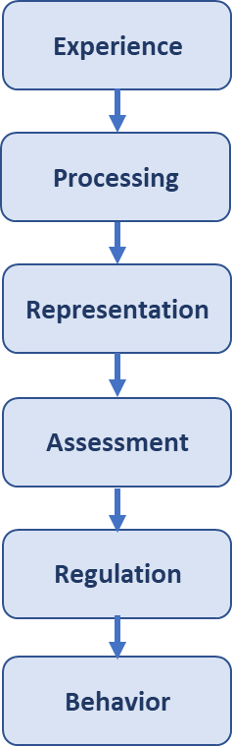
THE BIG QUESTION
How similarly do children and adults process the same affective information?
Notes:
when children and adults experience the same affective experiences,

Slide 23
THE BIG QUESTION
How similarly do children and adults process the same affective information?

Slide 24
THE BIG QUESTION
How similarly do children and adults process the same affective information?
Notes:
how do differences in neural hardware produce differences in representations?
If these structural and function developments can be observed do they result in any meaningful differences in processing as well?

Slide 25
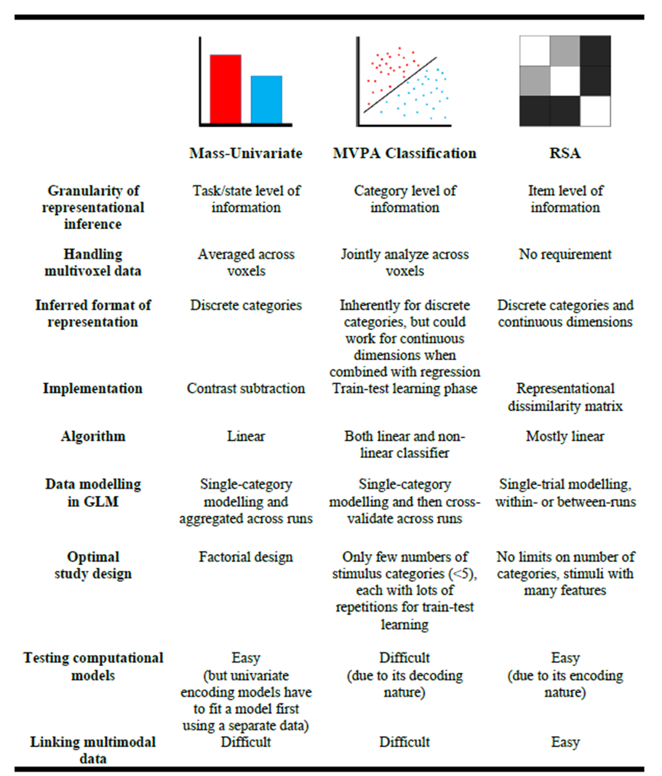
Univariate vs. Multivariate fMRI Analyses
Univariate approaches are great for questions at the level of comparing regions, but fail to highlight subtle pattern differences within regions.
Examining activation changes on a voxel-by-voxel level allows us to observe patterns and how they change as different stimuli are presented.
Popal, Wang, Olson, 2020
Notes:
One means of approaching neurocognitive questions like these is to
capture univariate means of neural activation across different conditions
And run contrasts between them to explore regional responses,
but these approaches don't allow us to explore more complex patterns within neural structure. (PAUSE)
Especially because, again,
Affective experiences are complex and nuanced and unfold over long time periods (PAUSE)
It may be the case that, if you were to present one individual with two different stimuli,
that they are thinking about them in very different ways.
(PAUSE)
But because, in a univariate analysis,
we are treating each voxel in a region as if it were interchangable with any other voxel in that region,
and then averaging the changes in value that correspond with the changes in stimuli across the whole region,
we are forced to focus on how one summed number represents activity in that entire region.

Slide 26
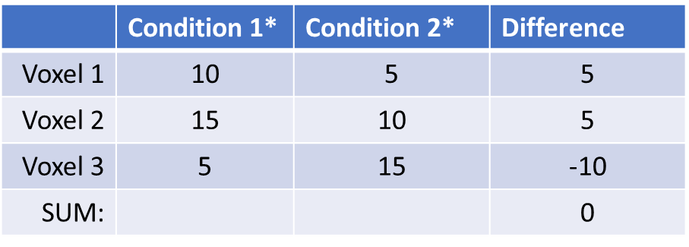
Univariate vs. Multivariate fMRI Analyses
Univariate approaches are great for questions at the level of comparing regions, but fail to highlight subtle pattern differences within regions.
Examining activation changes on a voxel-by-voxel level allows us to observe patterns and how they change as different stimuli are presented.
*Percent change in activation relative to baseline
Notes:
Maybe to drive this point a little better, we can picture a theoretical situation in which we want to look at an effect with two conditions
in one brain region that only has three voxels
(PAUSE)
Which is like, I wish it were only that easy, but anyway
(PAUSE)
With a univariate analysis,
we would measure the percent change in activation relative to baseline
within each voxel that we defined across both conditions.
(POINT TO VOXELS)
We’d find the difference in activation between conditions for each voxel,
and use the sum of that difference to represent how relevant that effect or process is for that region.
(POINT TO SUM)
If we just look at the difference sum, it doesn’t look like much is going on,
(POINT TO SCORES)
But on a voxel by voxel basis,
we see a lot of changes that are otherwise smoothed over by this approach.

Slide 27
Univariate vs. Multivariate fMRI Analyses
Univariate approaches are great for questions at the level of comparing regions, but fail to highlight subtle pattern differences within regions.
Examining activation changes on a voxel-by-voxel level allows us to observe patterns and how they change as different stimuli are presented.
Popal, Wang, Olson, 2020
Notes:
If we could instead examine that region voxel by voxel
and correlate activation among the voxels,
such that each voxel is treated as its own unique variable,
Rather than interchangeable,
we could instead focus on patterns of activation change rather than pure magnitudes
Those patterns would then be sensitive to these minute changes and allow us to examine changes in neural activation with greater nuance.

Slide 28
Introducing RSA
Representational Similarity Analysis (RSA) is a statistical methodology that allows us to analyze relative similarity among a set of stimuli based upon the pattern that response to the stimuli produces.
Popal, Wang, Olson, 2020
Notes:
So what a univariate method necessarily assumes to be noise
A Representational similarity analysis can make sense of and find signal within
(PAUSE)
At its core, what an RSA approach aims to do
is identify relative similarity and differences in patterns of neural activation in response to sets of stimuli.
(PAUSE)
It assumes some of the activation that follows the presentation of a stimuli is idiosyncratic
and a unique representation of how the subject processes that stimuli,
(PAUSE)
but that commonalities in the pattern of activation across different stimuli
represent common characteristics universal to that stimuli set
and I think that might sound complicated but the idea is fairly intuitive when framed differently.

Slide 29


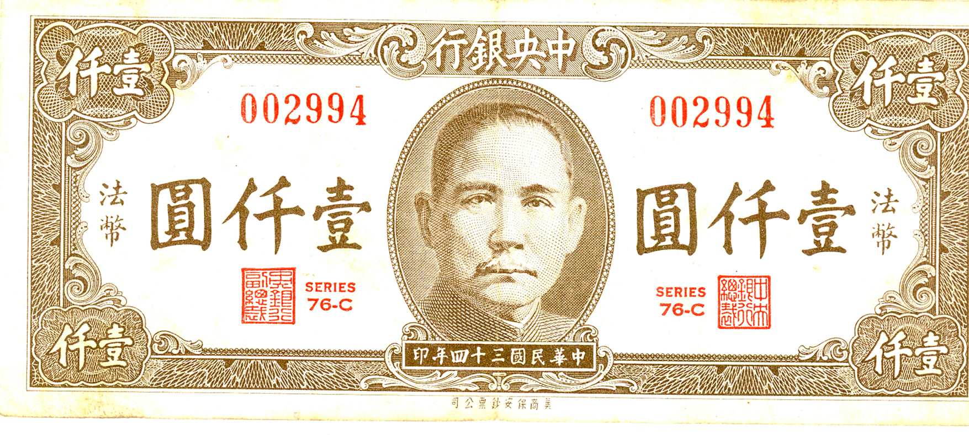








Introducing RSA
Representational Similarity Analysis (RSA) is a statistical methodology that allows us to analyze relative similarity among a set of stimuli based upon the pattern that response to the stimuli produces.
Notes:
If we were to show someone a lot of different images of all of the different types of currency
from different cultures,
time periods,
shapes,
sizes,
colors,
materials,
Just adding as much variability as possible while still sticking around this common theme of being currency,
we could infer
When we look at activation patterns
that any common pattern we find among all of them
is a representation of what they have in common,
That being currency.
And that would be someone’s representation of that item.
As such, an RSA approach typically demands a high volume of carefully crafted, variable stimuli to separate noise from signal.

Slide 30
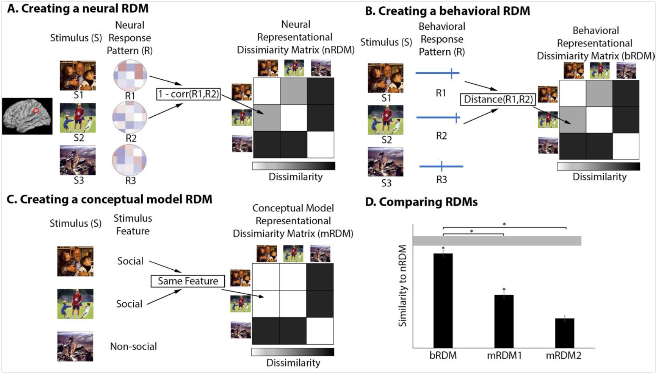
Introducing RSA
Representational Similarity Analysis (RSA) is a statistical methodology that allows us to analyze relative similarity among a set of stimuli based upon the pattern that response to the stimuli produces.
Popal, Wang, Olson, 2020
Notes:
Once all of these stimuli are presented and our data is collected,
we can then correlate the activity changes in voxels to themselves
over time and across subsequent stimuli presentations
And we can do this across the whole ROI
to examine how similar or dissimilar the resulting pattern is.

Slide 31
Introducing RSA
Representational Similarity Analysis (RSA) is a statistical methodology that allows us to analyze relative similarity among a set of stimuli based upon the pattern that response to the stimuli produces.
Popal, Wang, Olson, 2020
Notes:
These values are then stored in a correlation matrix.
We can then spatially analyze that matrix
Measuring how relatively dissimilar any one stimulus is from all of the other stimuli
(PAUSE)
or use the average of a group within a more traditional analysis of variance.
We then arrive at a value that symbolizes the strength of the representation of that valence for a particular region.
(PAUSE)
I just want to take a moment to note that the table and graphics here are not my own and I stole them from my friend Haroon Popal who wrote an amazing paper on applying RSA approaches to social stimuli which y’all should read if you’re interested in this technique.

Slide 32
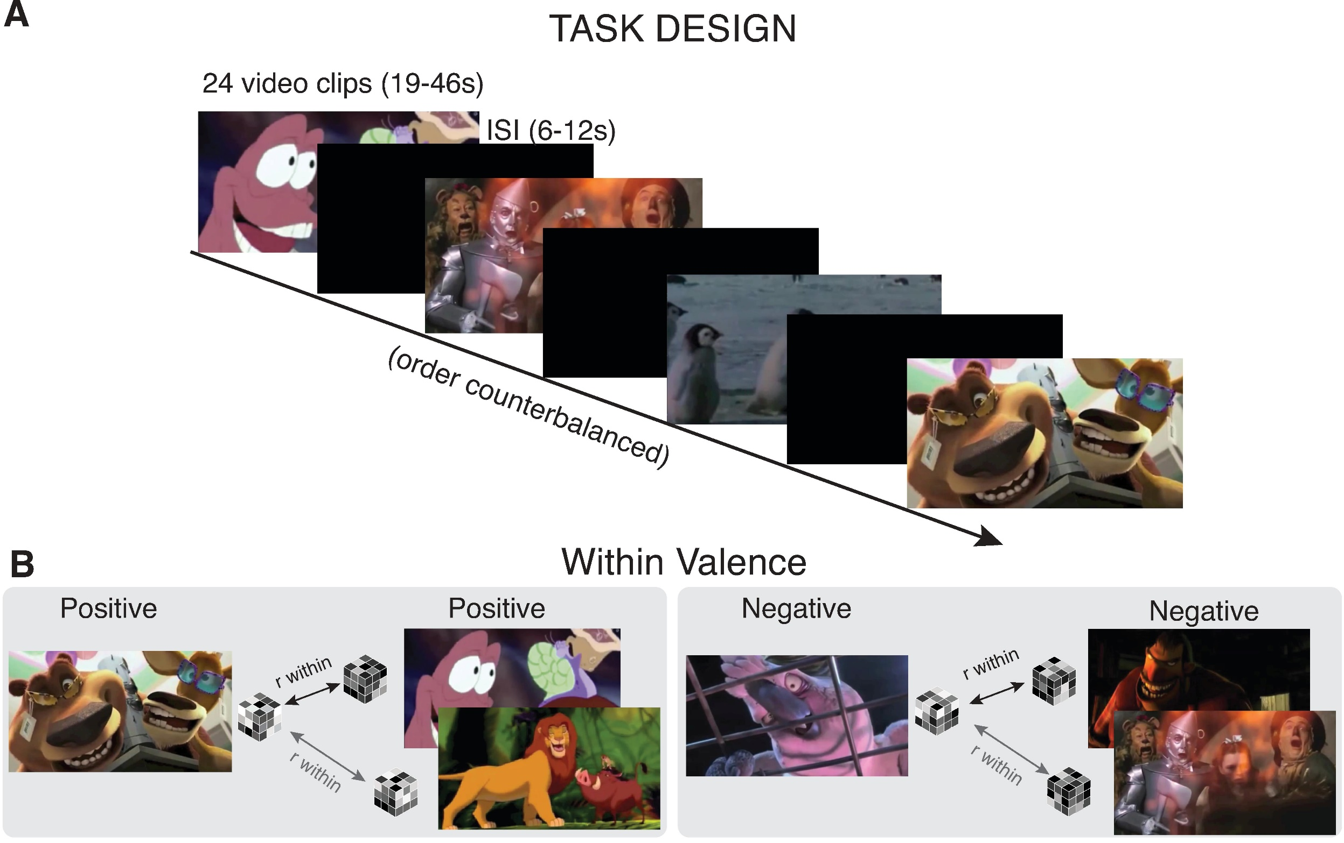
Why RSA?
Notes:
But, so, an RSA approach allows to us see with greater clarity
how similar representations of otherwise intangible properties are across different groups of people.
(PAUSE)
So if we could show different videos containing positive, negative, and neutral affective information
to adults and children
while they sit in an MRI machine
(PAUSE)
we could apply an RSA approach to their data and explore how similarly they were representing that information
and that's exactly what we did in our recent study.

Slide 33


Our Data
57 participants
36 children, 21 adults
12 excluded for excessive head motion
Final sample:
25 Children
ages 4-10 (M =7.4 yrs, sd = 1.85 yrs)
20 Adults
ages 20 - 44 (M =26.7 yrs, sd = 5.20 yrs)
Notes:
We used a dataset originally collected by Deepu Murty, Susan B. Perlman and her team,
I believe at the time of collection, they were at the University of Pittsburgh.
(PAUSE)
It includes 57 participants that were either children between the ages of 4 and 10,
or adults between the ages of 20 and 44
who passively viewed video stimuli within the context of fMRI
(PAUSE)
Unfortunately, NO ADOLESCENCE IN THIS DATASET
Which might be a real bummer to you
But whatcha gonna do?
(PAUSE)
Univariate analyses had previously been used on this data,
but no analyses explored affective representations within our ROIs of interest or used multivariate pattern analysis

Slide 34
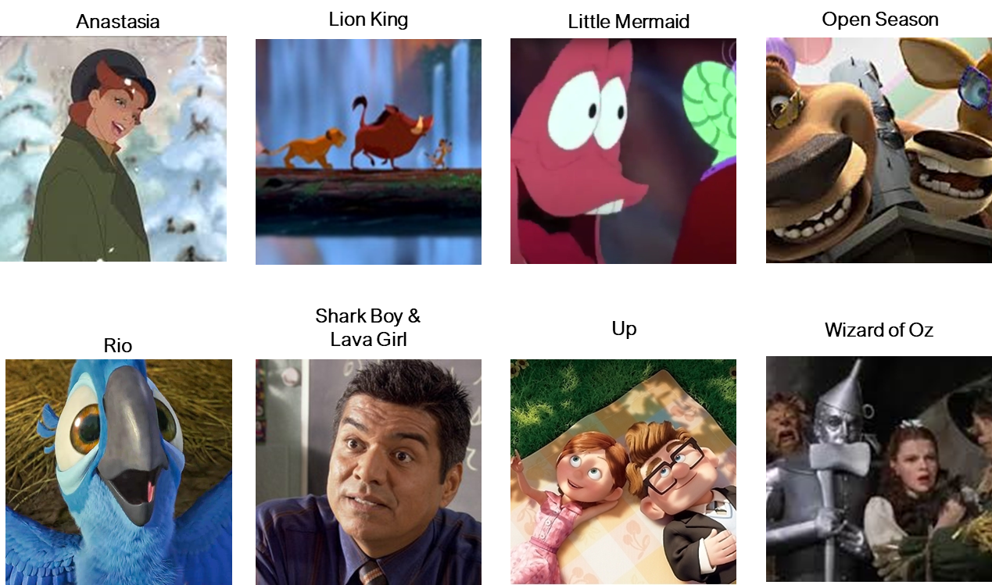
Stimuli
Notes:
Which is kind of mindblowing because it’s a really well designed set of stimuli to answer our big question
And in a way that perhaps better approaches ecological validity
relative to more traditional means of approaching this question.

Slide 35
Stimuli
Twenty-four clips from popular children’s movies
8 pos., 8 neg., 8 neut.
Each film provided 1 pos. and 1 neg. clip
Neut. clips sourced from nature documentaries
No difference between adult and child familiarity scores
Clips were randomized into three orders and assigned to participants at random
Notes:
It consisted of 24 clips from popular movies
that were evenly divided into positive, negative, and neutral valence categories.
(PAUSE)
Clips contained both animated and live action movies,
anthropomorphic and human characters
and spanned a long time period, with release dates from 1939 to 2011.
In total, participants were exposed to nearly 20 minutes of continuous stimuli
(PAUSE)
So, again, we have a high volume of stimuli with a lot of variability surrounding a few core common traits.

Slide 36
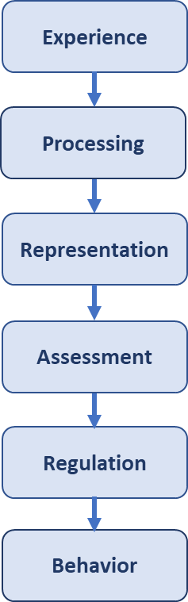
Stimuli
Twenty-four clips from popular children’s movies
8 pos., 8 neg., 8 neut.
Each film provided 1 pos. and 1 neg. clip
Neut. clips sourced from nature documentaries
No difference between adult and child familiarity scores
Clips were randomized into three orders and assigned to participants at random
Notes:
And in designing this dataset, we are ensuring that we are keeping the experience as consistent as possible for all of our participants.
While still approach the topic of affective experience in a more ecologically valid way than perhaps an IAPS picture set might.
Which again, nothing wrong with a picture set for certain questions

Slide 37

Here’s an example!
Notes:
But if we are to answer how similarly children and adults represent naturalistic affective experiences
We need stimuli that
has a timecourse,
is dynamic,
multimodal,
and sometimes social.
(PAUSE)
And so I thought it might be a good idea to give you all a little idea of what the clips were like,
so here’s one from an movie called Open Season

Slide 38
Hypotheses
Children will demonstrate greater representational similarity than adults.
1
Children will generate greater discrepancies in valenced representational similarity than adults.
2
Children and adult subcortical ROI representations will be more similar than representations in the vmPFC.
3
COMPLEXITY
DIFFERENTIATION
MEANING MAKING
Notes:
So off of all of that background, we formed a few hypotheses.
It’s a little general,
But our first one was just generally exploring complexity
Will children generate greater pattern similarity than adults, and we think that should be the case.
(PAUSE)
Next,
Because of differentiation models,
And research like that of Pons et al., 2014
we expected children to generate representations that fell pretty strongly along valence lines,
while the complexity of affective representations in adulthood
Might render valence to be an insufficient framework to apply to adult representations.
(PAUSE)
Lastly, and I apologize for the ambiguous buzzword term on this,
but because of the profound functional and connective prefrontal developments,
relative to subcortical developments,
we expected to see an interaction
Such that the difference in pattern similarity between child prefrontal and subcortical regions
should be greater than the difference between adult prefrontal and subcortical regions.
(PAUSE)
And of course, we take this to be a sign that adults are generating greater ability in that post-representation assessment stage.

Slide 39
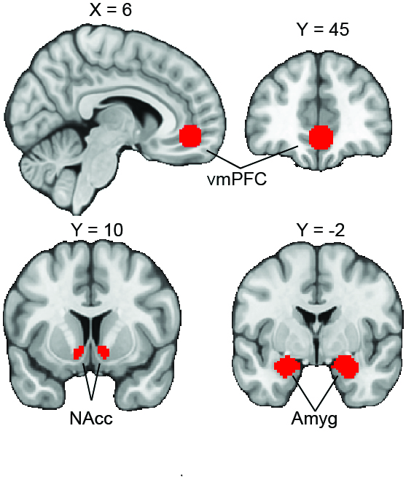
Regions of Interest
Amygdala
Nucleus Accumbens
Ventromedial Prefrontal Cortex
Masks Used
Notes:
So we identified three regions relevant to our question:
the Amygdala, the nucleus accumbens within the ventral striatum,
and the ventromedial prefrontal cortex.
(PAUSE)
We defined our amygdala and nucleus accumbens ROIs using the masks contained within the Harvard-Oxford subcortical atlas,
but used a 10mm diameter activation-centered isotropic kernel to define the vmPFC.
(PAUSE)
The mask centered on coordinates identified in a metaanalyses by Bartra and colleagues
as the most common center of consistent vmPFC activation during studies of subjective valuation and primary incentives.

Slide 40
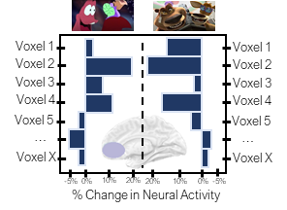
Analyses
Notes:
Once our data was collected, warped, pre-processed, outliers were removed, and lower level analyses ran,

Slide 41
Analyses
R Value
Notes:
we then correlated our voxels to themselves within participant and region, but between video. It’s notable that we never correlated clips from the same movie, as there likely would have been to much non-affective overlap in the patterns.
Running these correlations resulted in finding one R value that represented pattern similarity between this pair in this region for this person.

Slide 42
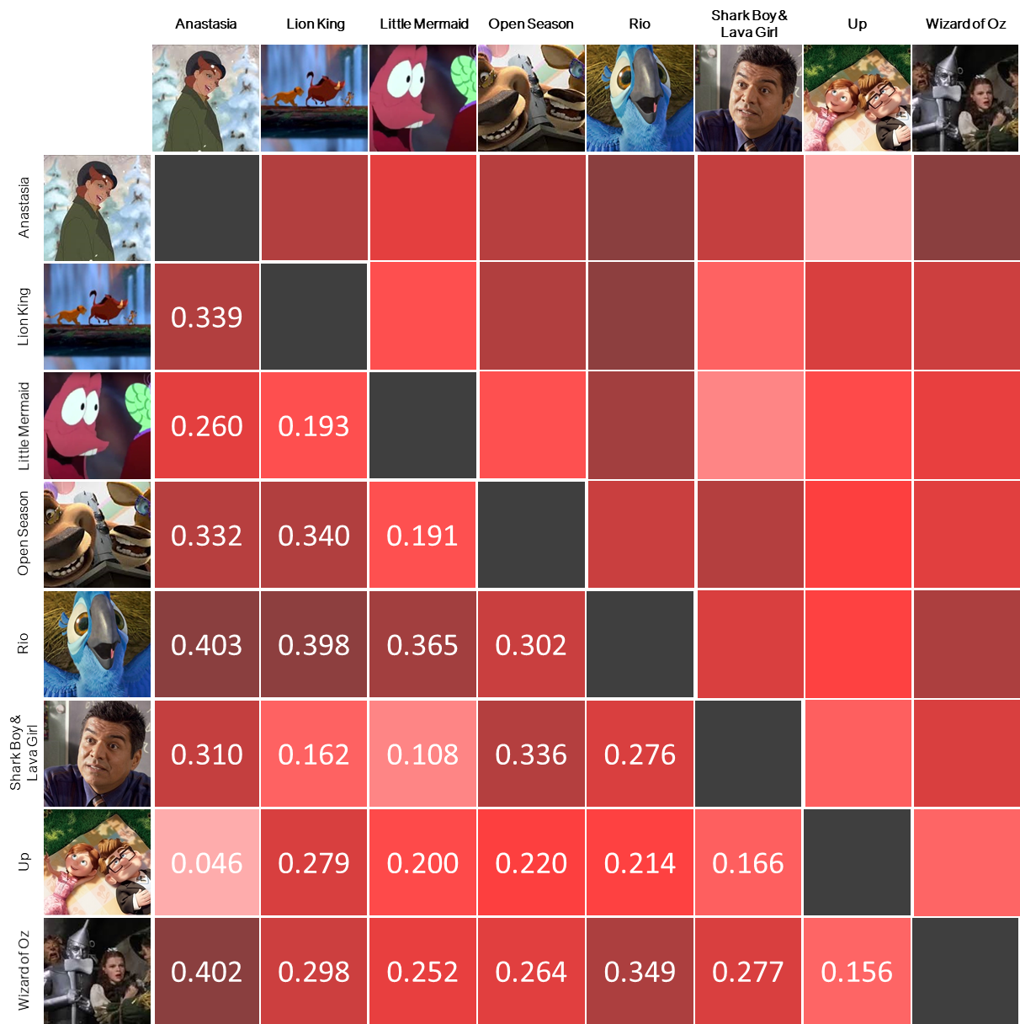
Analyses
R Value
Notes:
We then placed those values within matrices

Slide 43
Analyses
R Value
Notes:
And here you can see that for these two movies

Slide 44
Analyses
R Value
Notes:
They had a relatively low pattern similarity score.
After computing our RSA values using a Spearman Rank Correlation and applying a Fisher’s Z transformation,
We entered our values into a 3 x 3 x 2 Mixed Effects ANOVA, with terms for ROI, Valence, Age Group, and interactions among them.
Additional contrasts were pursued post-hoc and Bonferroni-adjusted.

Slide 45

Stimuli
Notes:
Then just as a reminder, here’s the study design once again
(PAUSE)
By first categorizing stimuli into valence groups,
presenting participants this stimuli, and then comparing subsequent patterns using correlations within stimuli group,
we can examine how similarly adults and children are representing this valenced affective information.
And so what did we find?

Slide 46

Supported
Overall, children did demonstrate greater pattern similarity relative to adults
Notes:
We supported our first hypothesis.
Overall, children did demonstrate greater pattern similarity in response to these affectively valenced stimuli relative to adults.
This does suggest that these neural changes are producing greater complexity in activation patterns for adults relative to children.

Slide 47

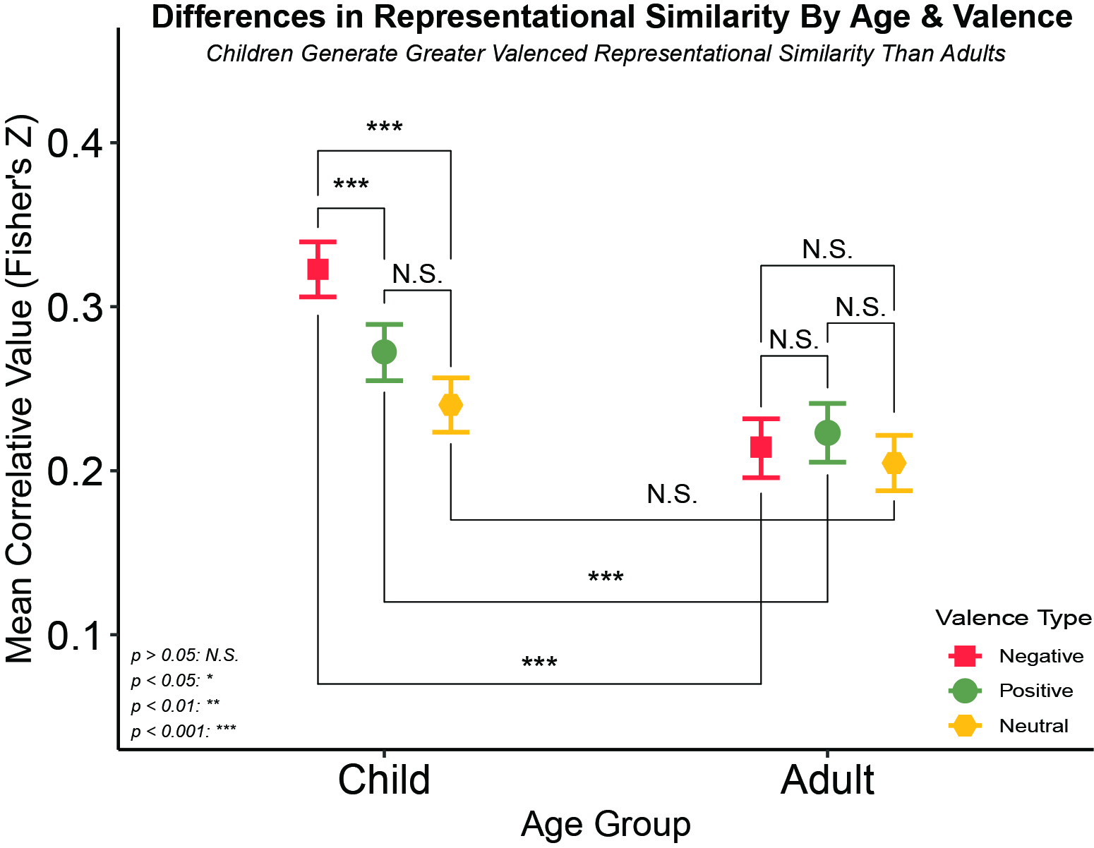
Supported
Children Generate Greater Valenced Representational Similarity Than Adults
Children also demonstrated greater affective pattern similarity relative to our neutral control, while adults did not seem to differentiate along affective lines.
Notes:
Next, we examined affective valence, and found support for our hypotheses, though, the picture is slightly more complicated
On the X axis, we have our age groups,
on the y axis we have our correlative values,
so higher values mean that the patterns we observed were more similar to each other,
and lower values mean that they were less similar to each other within that specific Age / Valence group.
And lastly, we have valence as our moderator with relevant key over to the right.

Slide 48
Supported
Children Generate Greater Valenced Representational Similarity Than Adults
Children also demonstrated greater affective pattern similarity relative to our neutral control, while adults did not seem to differentiate along affective lines.
Notes:
First, we see no differences among adults by valence
This is in line with what we suspect, that valence might not be as appropriate of a heuristic or model for adults, being too general

Slide 49
Supported
Children Generate Greater Valenced Representational Similarity Than Adults
Children also demonstrated greater affective pattern similarity relative to our neutral control, while adults did not seem to differentiate along affective lines.
Notes:
For children, we do see differences between negative and positive and positive and neutral,
But interestingly enough not positive and neutral
This difference could be a product of the prominence a lot of negatively valenced events enjoy
Especially in moral domains for children.

Slide 50
Supported
Children Generate Greater Valenced Representational Similarity Than Adults
Children also demonstrated greater affective pattern similarity relative to our neutral control, while adults did not seem to differentiate along affective lines.
Notes:
But, most important,
We see that both positive and negative, but not netural valenced stimuli,
Generated greater pattern similarity in children relative to adults,
Again which suggests that children are representing negative things pretty similarity to other negative things
And positive things pretty similarity to other positive things,
And not differentiating as much nuance as their adult counterparts seem to be doing

Slide 51
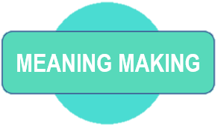
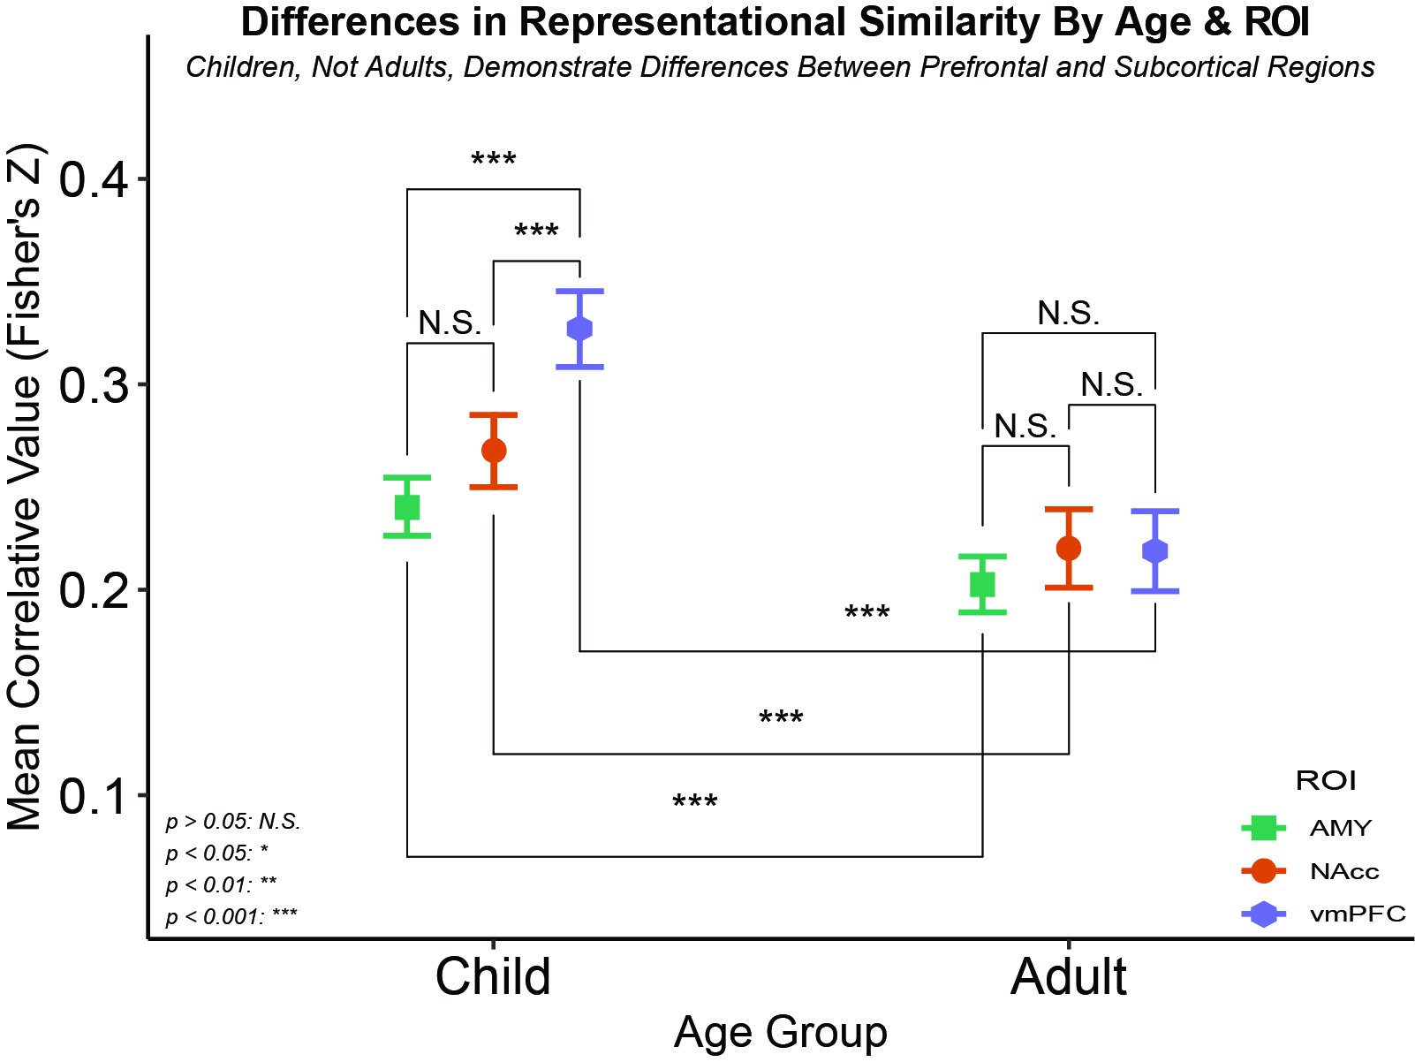
Supported
Adults demonstrated no ROI differences while children demonstrated differences between the vmPFC and each subcortical structure
Notes:
For our third hypothesis
We have a very similar set up
On the X axis, we have our age groups,
on the y axis we have our correlative values,
And lastly, we now have ROI as our moderator with a little reminder of where each region is located on the left.

Slide 52
Supported
Adults demonstrated no ROI differences while children demonstrated differences between the vmPFC and each subcortical structure
Notes:
We again see little pattern similarity among adults by region

Slide 53
Supported
Adults demonstrated no ROI differences while children demonstrated differences between the vmPFC and each subcortical structure
Notes:
However, children show far greater pattern similarity in the vmPFC than they do subcortical regions

Slide 54
Supported
Adults demonstrated no ROI differences while children demonstrated differences between the vmPFC and each subcortical structure
Notes:
Despite all regions showing a movement towards greater dissimilarity overall in the older cohort, the difference between the vmPFC and subcortical regions is more pronounced in children relative to adults.

Slide 55

Implications
Affective representations may decrease in pattern similarity over normative development
Notes:
Reflective of experiencing a maturation from visceral affective responses that merely assess how evocative an affective experience is, to more evaluative analyses which modulate affective responses between childhood and adulthood
Our results finding age specificity in pattern similarity is in line with developmental perspectives of the vmPFC’s role in emotional processing and aligns with past work demonstrating distinctions between this area’s function across age
Taken together, a potential interpretation of our findings is that, in light of the region’s role in processing of emotional stimuli, the pattern and response similarities we find in children may signal their shared, relativelylimited experience of the vast array of potential affectively relevant experiences, while adults respond more divergently to novel affectively valenced information by referencing a wider berth of past evaluations.
Appraisal theories of emotion broadly posit that emotions are elicited by or are emergent phenomena from evaluations of events and circumstances
this postulation fits nicely with rational constructivist-related theories of emotional development, in which humans start with proto-conceptual primitives to emotion that mature over time due to language and symbol learning,
Bayesian inductive learning and constructive thinking mechanisms (Hoemann et al., 2019; for a review, see Fedyk and Xu, 2018).
While adults did demonstrate lower levels of similarity in response to valence than children, it is notable that the correlation was not non-existent. As a result, valence likely still plays a role in shaping some aspects of decision-making and behavior and may explain the findings like those suggesting greater homogeneity in response to norm violations of negative affect than positive affect, with targets who express positive or neutral responses to negatively perceived stimuli to be judged as less authentic (Krumhuber and Manstead, 2009), socially appropriate and less liked (Ansfield, 2007), as well as punished more harshly than incongruent responses to differently valenced stimuli (Szczurek, Monin, and Gross, 2012). These findings support previous suppositions regarding an information value asymmetry between positive and negative affective experiences, as negative information may signal a need for adjustment to avoid detrimental consequences (Pratto and John, 1991; O’Toole et al., 2020).

Slide 56
Implications
Affective representations may decrease in pattern similarity over normative development
Notes:
Reflective of experiencing a maturation from visceral affective responses that merely assess how evocative an affective experience is, to more evaluative analyses which modulate affective responses between childhood and adulthood
Our results finding age specificity in pattern similarity is in line with developmental perspectives of the vmPFC’s role in emotional processing and aligns with past work demonstrating distinctions between this area’s function across age
Taken together, a potential interpretation of our findings is that, in light of the region’s role in processing of emotional stimuli, the pattern and response similarities we find in children may signal their shared, relativelylimited experience of the vast array of potential affectively relevant experiences, while adults respond more divergently to novel affectively valenced information by referencing a wider berth of past evaluations.
Appraisal theories of emotion broadly posit that emotions are elicited by or are emergent phenomena from evaluations of events and circumstances
this postulation fits nicely with rational constructivist-related theories of emotional development, in which humans start with proto-conceptual primitives to emotion that mature over time due to language and symbol learning,
Bayesian inductive learning and constructive thinking mechanisms (Hoemann et al., 2019; for a review, see Fedyk and Xu, 2018).
While adults did demonstrate lower levels of similarity in response to valence than children, it is notable that the correlation was not non-existent. As a result, valence likely still plays a role in shaping some aspects of decision-making and behavior and may explain the findings like those suggesting greater homogeneity in response to norm violations of negative affect than positive affect, with targets who express positive or neutral responses to negatively perceived stimuli to be judged as less authentic (Krumhuber and Manstead, 2009), socially appropriate and less liked (Ansfield, 2007), as well as punished more harshly than incongruent responses to differently valenced stimuli (Szczurek, Monin, and Gross, 2012). These findings support previous suppositions regarding an information value asymmetry between positive and negative affective experiences, as negative information may signal a need for adjustment to avoid detrimental consequences (Pratto and John, 1991; O’Toole et al., 2020).

Slide 57
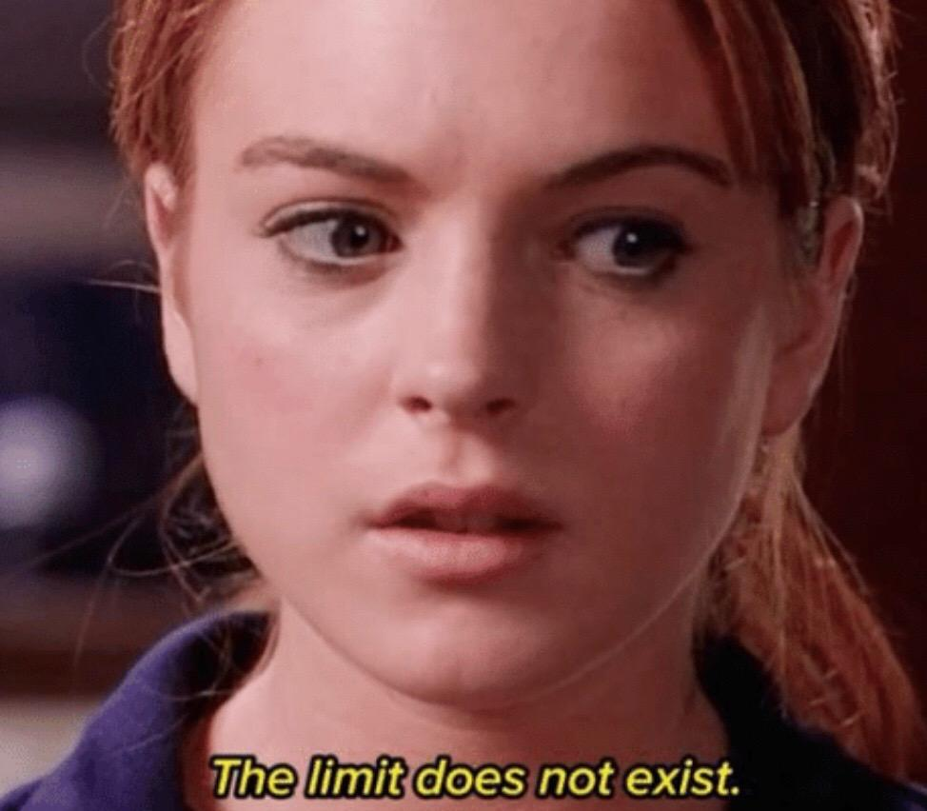

Limitations of Our Approach
Lack of adolescent representation
Cannot make causal developmental claims
Cannot comment on contents of representations
Cannot connect representations to behavior
Relatively small sample size
Notes:
Let me tell you about some of the ways we are trying to build upon what we found

Slide 58


Notes:
In one ongoing study we are using movies and tv shows widely available to a general audience
to gauge affective decisions and responses continuously throughout exposure
and using novel analyses like hyperalignment to observe this process across participants.

Slide 59
Notes:
This sort of is assessing differences at what I’m characterizing as the assessment or meaning making stage.

Slide 60
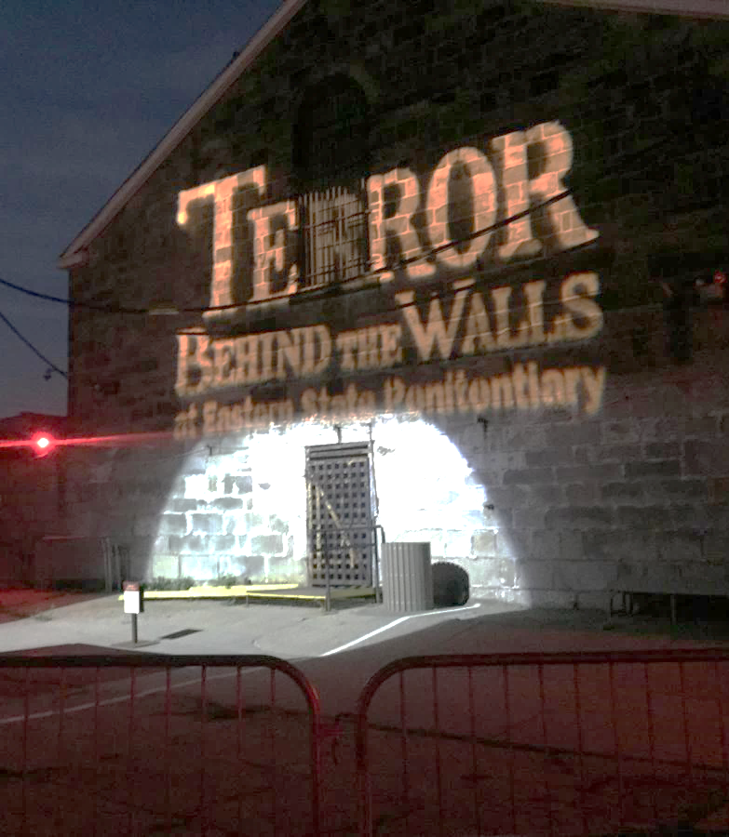
Notes:
But We also have an ongoing project in collaboration with the Murty Adaptive memory lab
in which we take participants to these quasi-naturalistic settings to measure emotional responses
in populations that have no regulation training
or really any idea that they are in a regulation study.
So in that we can assess contextual fit for self-reported cognitive process, behavioral processes,
and a whole other dimensions that I didn’t include here, that being physiological processes as well

Slide 61
Why Does Emotion Regulation Matter?
Emotions motivate us and help us achieve goals
Critical for:
Normative development
Communication
Interpersonal relationships
Personal success
Clinical populations
Addiction
Mania
Anxiety
Depression
Notes:
To wrap it up
emotions matter for all of us.
(PAUSE)
We all allow emotions to motivate us and help us better achieve our goals.
This is in line with instrumental theories of emotion.
And because emotions can be these really powerful tools,
we ideally want a reasonable degree of control over them.
(PAUSE)
For some groups, the dangers of not regulating rise even above
The risks of, for example, not regulating your anger when someone expresses some vaccine misinformation
or not showing enough joy when someone gives you a gift.
(PAUSE)
Of course, I don’t think I need to
At this stage, or to this audience
Explain why development self-regulation is important
(PAUSE)
But not regulating positive and negative emotions can be especially problematic for those suffering from addiction and mania as well
Who benefit from reducing high levels of positive emotion,
And anxiety and depression,
whose treatment outcome success is influenced by regulatory control over negative and positive emotions.
And so ya know, if I can leave you off with one note

Slide 62
Why Does Emotion Regulation Matter?
Emotions motivate us and help us achieve goals
Critical for:
Clinical populations
Addiction
Mania
Anxiety
Depression
Normative development
Communication
Interpersonal relationships
Personal success
Notes:
It’s that context matters, whether you are studying emotion or experiencing emotion yourself.

Slide 63

Special Thanks to:
Chelsea Helion
Susan B. Perlman
Lindsey Tepfer
Susan Benear
Ginny Ulichney
Joanne Stasiak
Alina Spas
Melissa Rosahl
Tiara Bounyarith
Makiya Murphy
Deepu Murty
Nicole Henninger
Elizabeth Horwarth
Joy Ham
Helen Schmidt
Ian O’Shea
Sophia Tran
Angelique Vittone
Shay Richardson
Adhya Gowda

Slide 64


